Slide 1


Divorce Analysis & Prediction
AIT 664-DL1
By: Sneha Kumaran, Xiaoqing Liu, and Shrijana Oli

Slide 2
Outline
-Introduction-
-Research Questions-
-Dataset-
-Preprocessing/Cleaning Dataset-
-Data Exploration-
-Evaluation & Interpretation of Data Exploration-
-Model & Algorithm-
-Evaluation & Interpretation of Model & Algorithm-
-Conclusion-

Slide 3
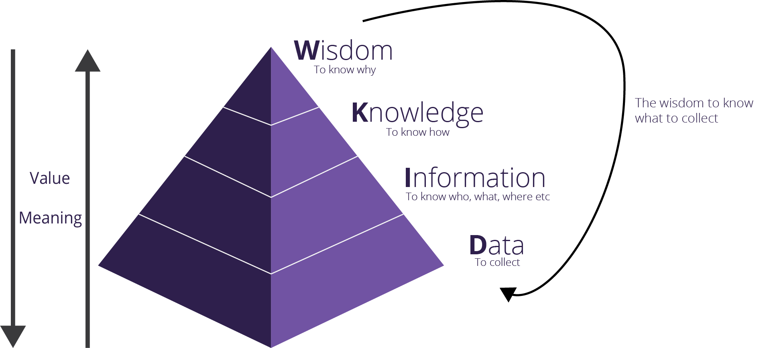
Introduction
Divorce is the process of canceling/terminating a marriage between partners
Results into many complex relationship once the partners tend to dispute
Causation?
Personal
Interpersonal
Societal factors
Psychological influence
Getting a divorce can impact many situations which takes a toll financially, emotionally, and other members of the family
Using few datasets, we will analyze and interpret what leads to a divorce and how the rates of divorce are increasing in many nations

Slide 4
Research Questions
Which factors could lead to a divorce?
Based on how correlated the attributes and factors are, we can determine which psychological factor or statement will lead to a divorce
What is the current situation of divorce in the US? Is it still a topic that need to be seriously considered compared to other countries?
A dataset included in order to analyze the rate (world_divorces_per_1000_people.csv). This analysis will help us visualize how divorce impacts the nations and emphasizing how important divorce can play a role in the society.
How accurately can the models predict on how many couples are heading towards a divorce?
Using Python and R Studio, we will determine how efficient and true the models will predict based on many algorithms (Logistic Regression, Random Forest, KNN, and Naive Bayes )

Slide 5
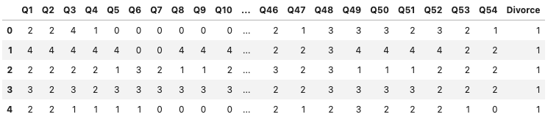
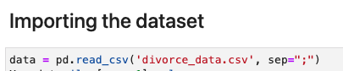
Dataset
Main Dataset: Divorce Prediction [1]
UCI Machine Learning Repository
A collection of 54 questions/statements asked by psychologist and a therapist to 170 divorced or married couples.
CSV file
Categorical Values
Questions and statements are answered by a graded scale from 0 to 4, where 0 = Never, 1 = Seldom, 2 = Average, 3 = Frequently, and 4 = Always
Attributes are labeled by: Q1, Q2, Q3…Q54, Divorce
Divorce represented by [0] (No Divorce) or [1] ( Divorce)
Each Row represents a ID of a couple

Slide 6
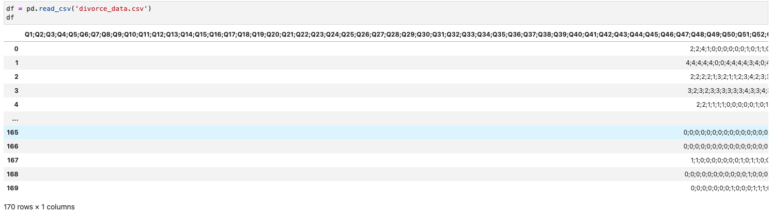
Divorce Prediction Dataset Before Clean up and Proper Import

Slide 7
Benefits of our Divorce Prediction Dataset
The dataset is balanced
49% were divorced, 51% were married.
49% were males, 51% were females.
The samples are diverse
43.5% were married for love and 56.5% were married in an arranged marriage.
Participants were in different education levels
Participants had different monthly income
Possible outliers are avoided
For the married participant, those who had thoughts of divorce had been excluded. This approach may help to reduce the impact of outliers on the results of the study and increase the accuracy of the findings.

Slide 8
Bias in our Divorce Prediction Dataset
We believe there are a lot of bias in this dataset
Selection Bias is one problem, because there aren’t much information of the couple given through the dataset
No Demography
No Geography
No Time
Not all the population that are divorced or married are represented properly
The population or the dataset size could be increased as well to get a better result on the accuracy of this topic
Sampling Bias

Slide 9
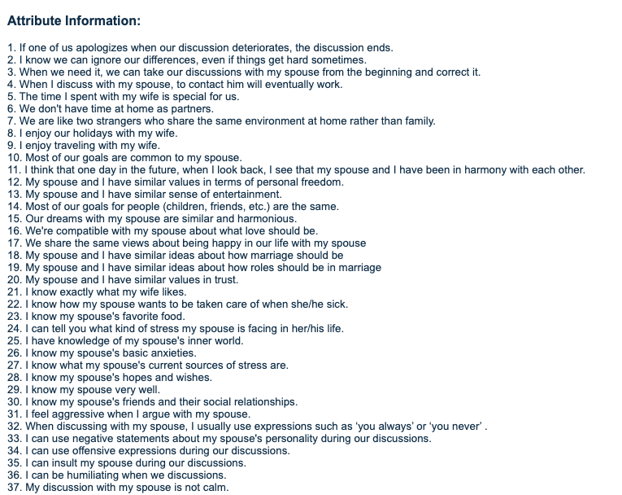
Dataset
Questions/Statements:

Slide 10
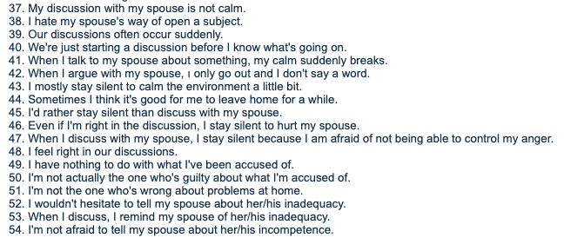
Dataset
Questions/Statements:

Slide 11
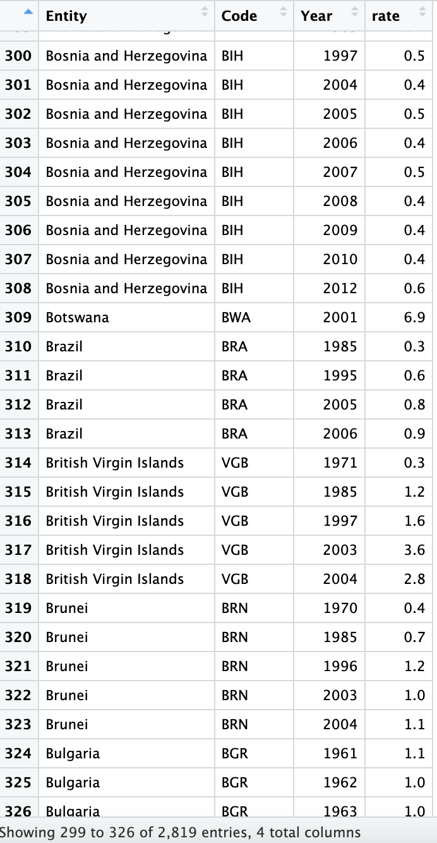
Dataset
Second Dataset: World Divorce Rate Dataset [2]
Our World in Data: Marriages and Divorces - Our World in Data
Four features: Entity, Codes, Year, rate
Divorce rate: The number of divorces per 1,000 people
The dataset includes divorce rates in 167 countries
Time for data recording of countries are different. (for U.S., from 1920 to 2018)

Slide 12
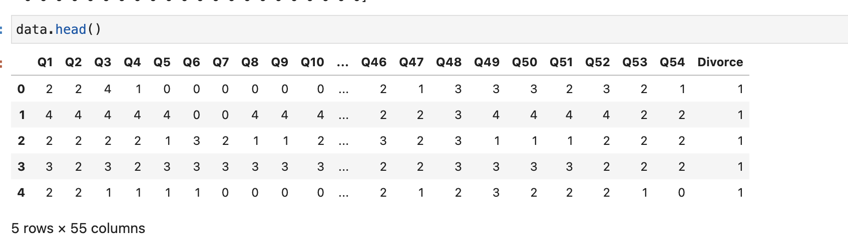
Data Loading & Preprocessing
Python:
Imported necessary modules and libraries like numpy, matplotlib, seaborn, pandas, plotly, from sklearn (imported preprocessing), and scipy.io
Loaded/Imported Main Dataset - Divorce Prediction
CSV file and loaded using Pandas library -> data = pd.read_csv('divorce_data.csv', sep=";")
Split the X and y values
X = Q1-Q54 columns
y = Divorce column
Checked if there are null values -> (no null values)
Method: null = data.isnull().sum().sort_values(ascending=False)
Checked if there are any missing values -> (no missing values)
Method: Used SimpleImputer Package from sklearn.impute module to fill the missing values with the mean of the column

Slide 13
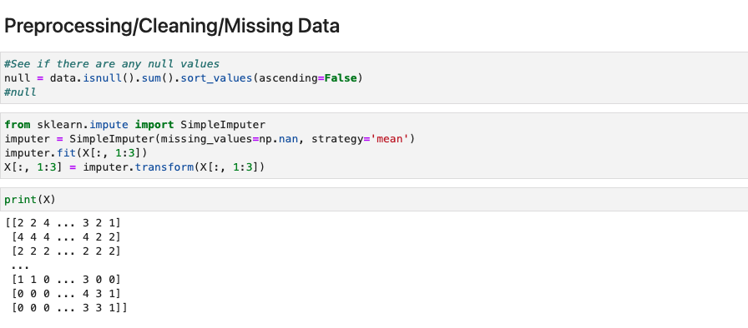
Data Loading & Preprocessing

Slide 14
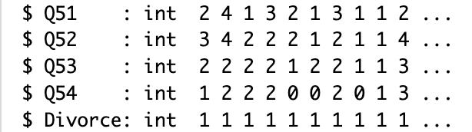
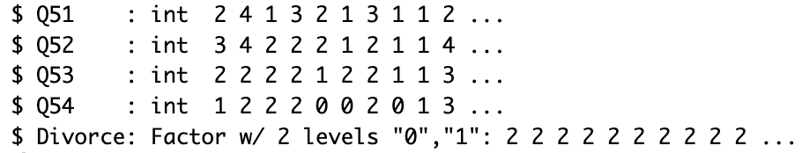
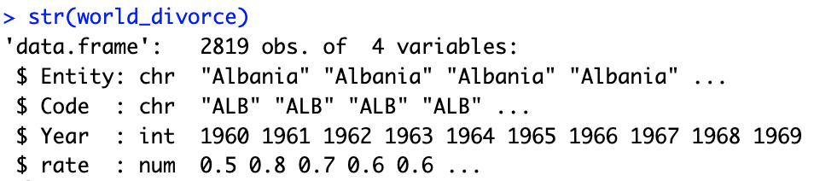
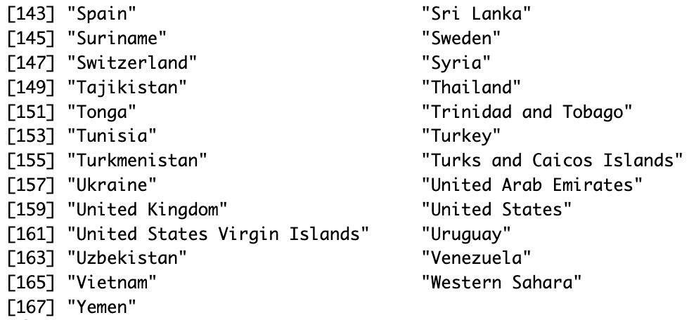
Data Loading & Preprocessing
R:
Import libraries: tidyverse, GGally, bestglm,
randomForest, corrplot, caret, naivebayes.
Main dataset
Load the cleaned dataset - Divorce Prediction
Convert the target “divorce” from integer to factor
Second dataset
Transfer the original xlsx file to csv file
Checked if there are na values -> (no na values)
Method: sum(is.na(world_divorce)) -> return 0
Check structure, dimension of dataset
Method: str(world_divorce)
Check all the included countries
Method: unique(world_divorce$Entity)

Slide 15
Data Exploration - Main Dataset
Analyze the frequency of how the couples have rated each question with a grade, see the correlation, and we will aim to identify potential predictors of divorce and understand their distributions and relationships with the target variable [Divorce].
Created a bar chart and a pie chart
See which attributes are highly correlated within each other using the target variable and determine which highly correlated factors lead to a divorce.

Slide 16
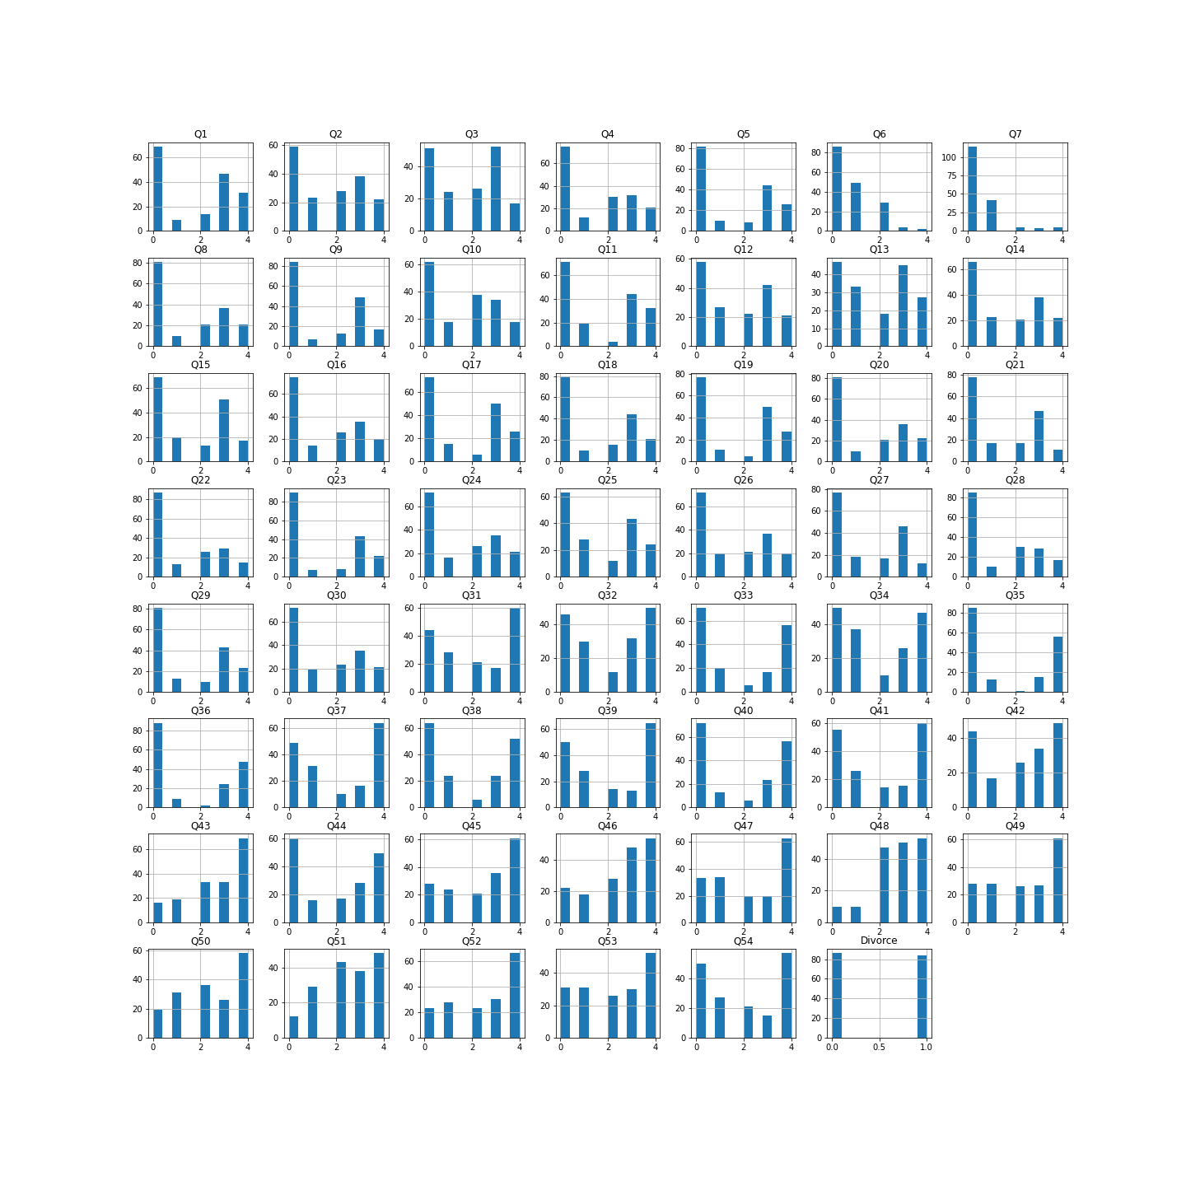

Slide 17
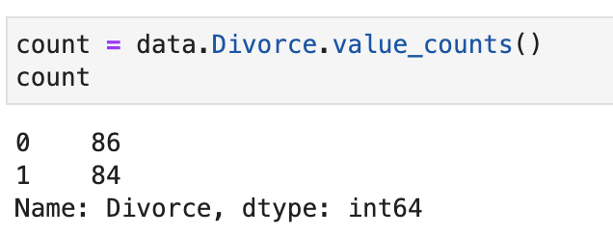
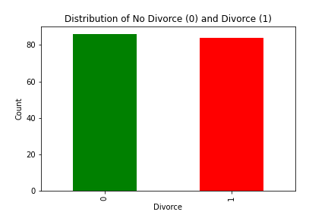
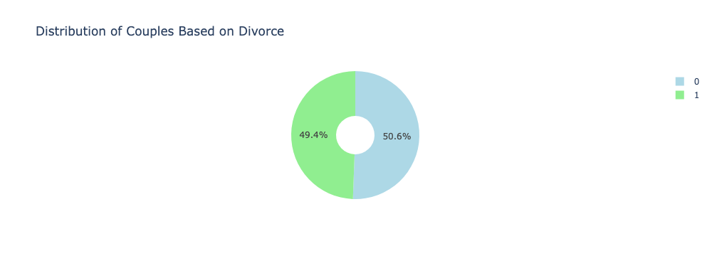
Data Exploration - Target Variable

Slide 18
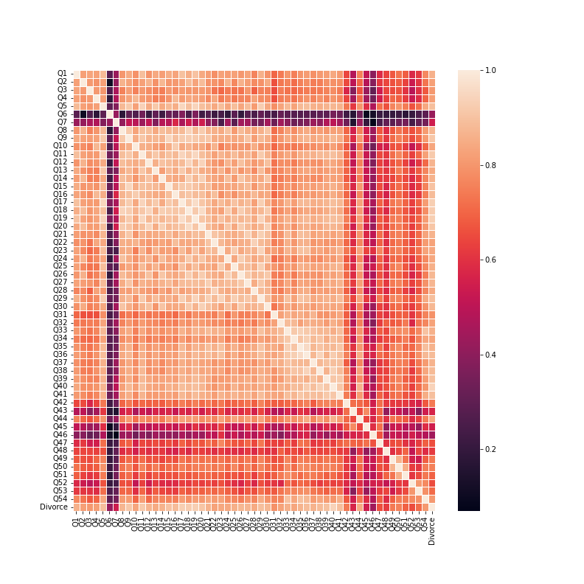
Correlation Matrix on Main Dataset
If color goes under 0.2, it means that the features aren’t strongly correlated within each other.
It is better to be above 0.8. It is more positively correlated.
Features such as Q8-Q30 have high correlation within each other.

Slide 19
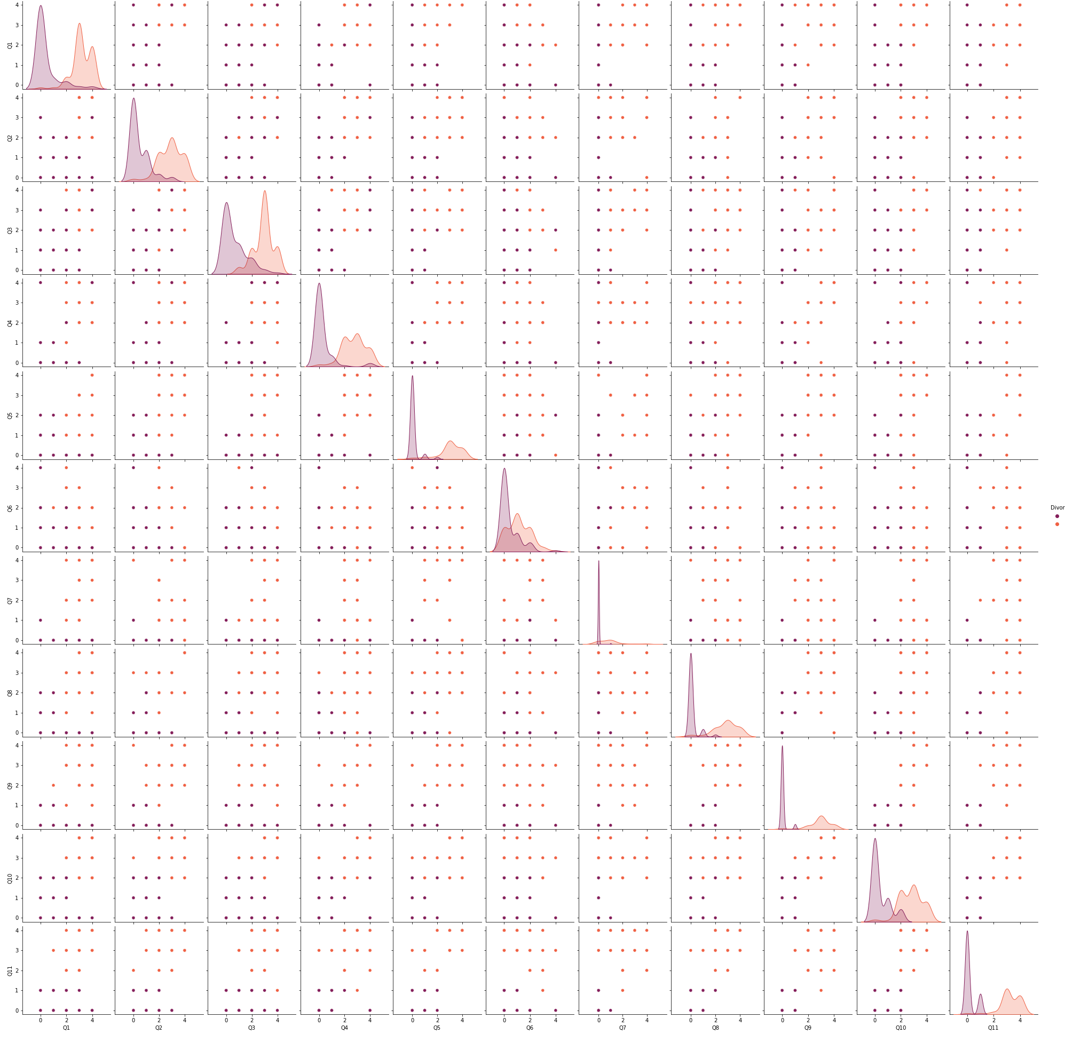
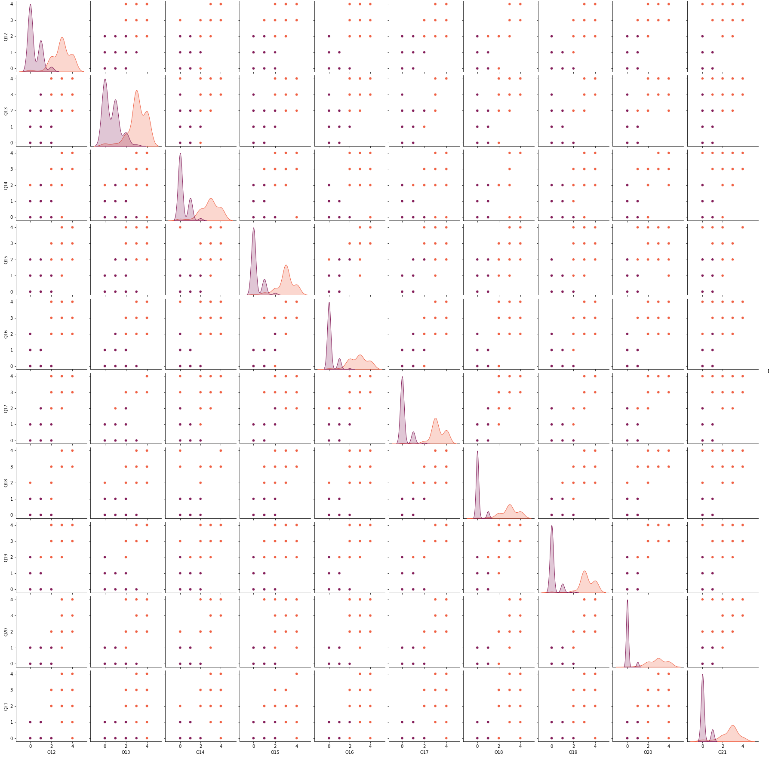
Pair Plots Using Python Q1-Q11 & Q12-Q21

Slide 20
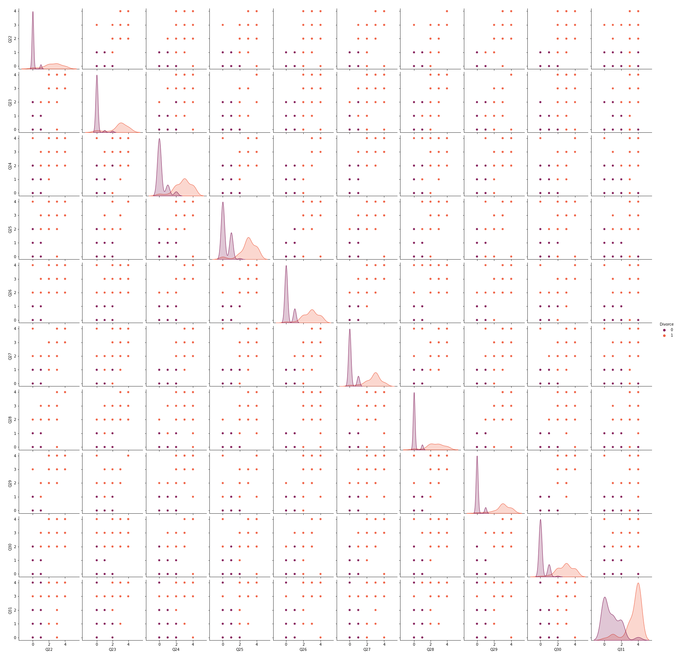
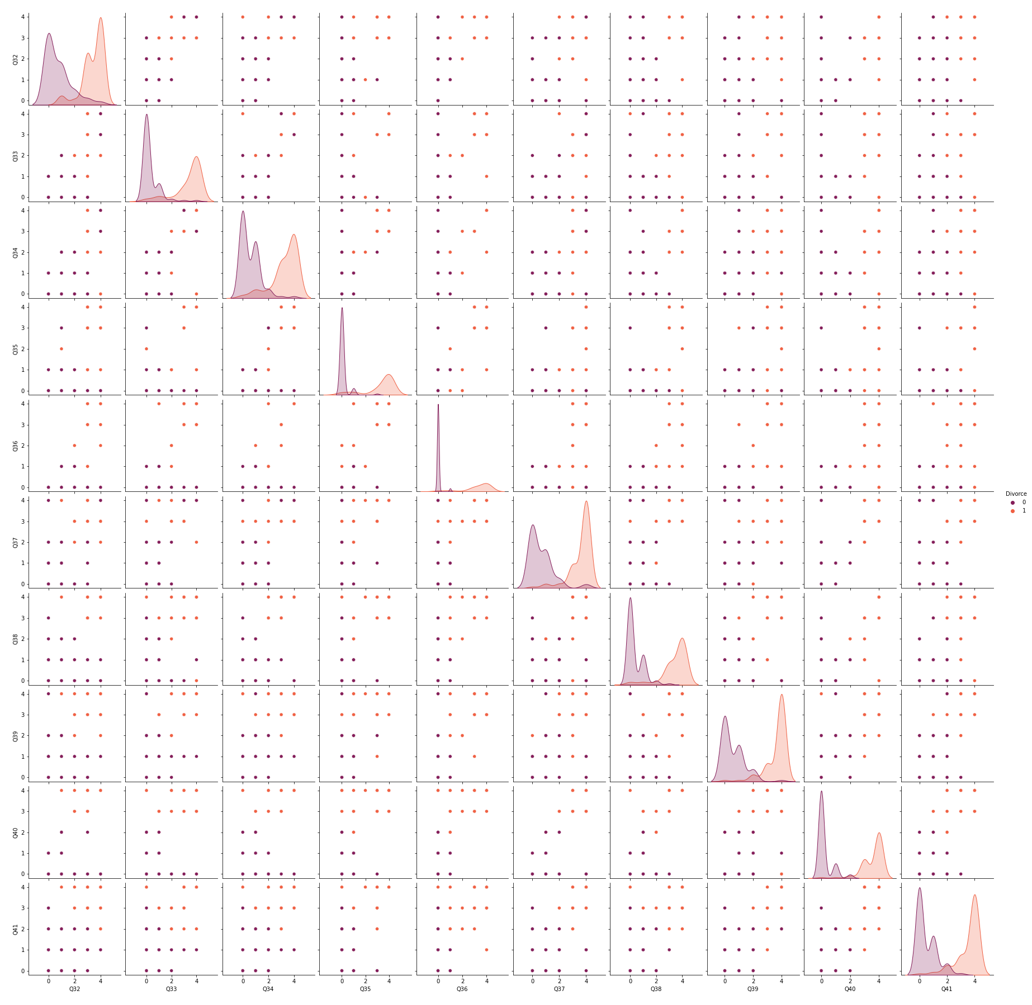
Pair Plots Using Python Q22-Q31 & Q32-Q41

Slide 21
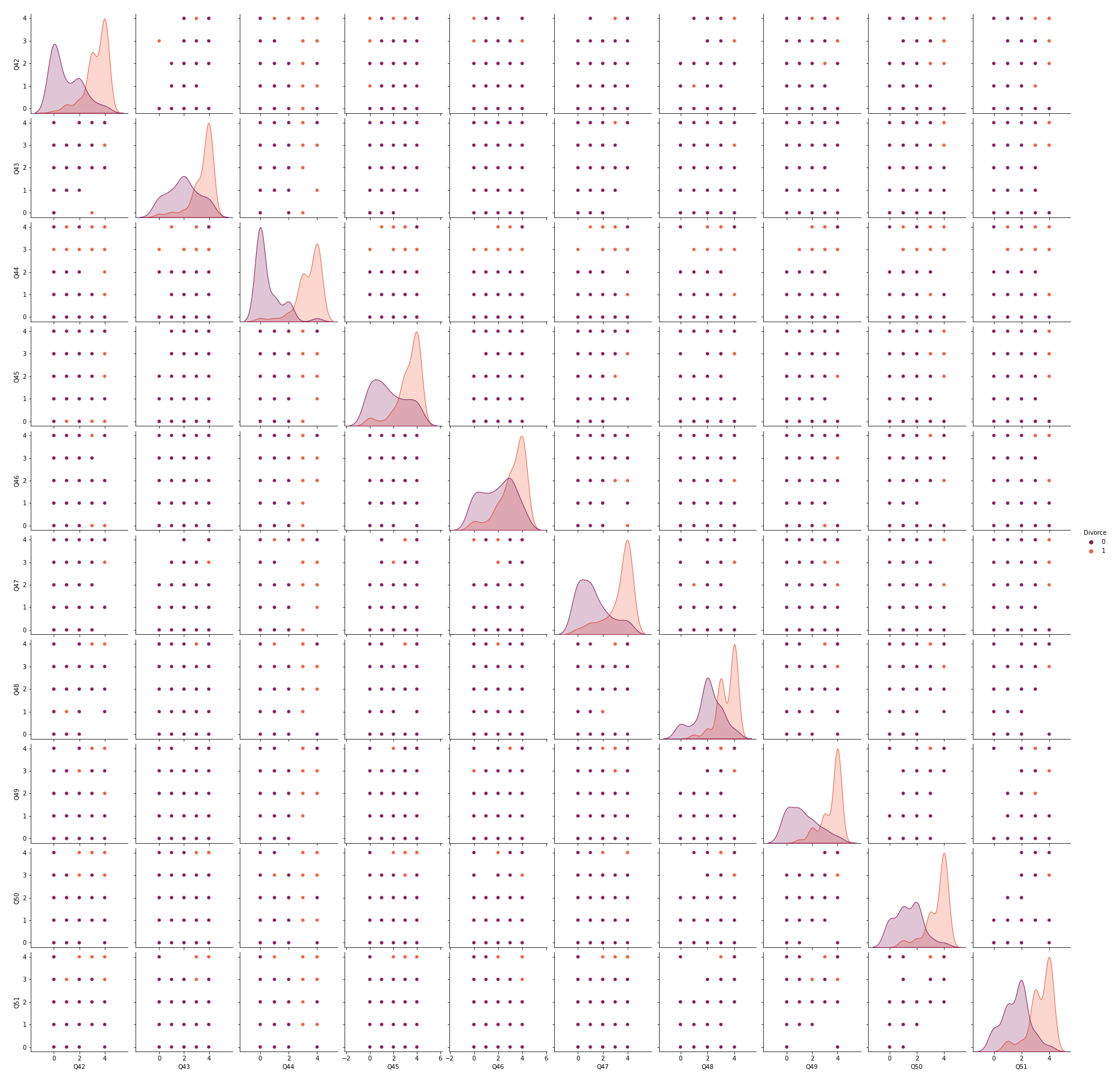
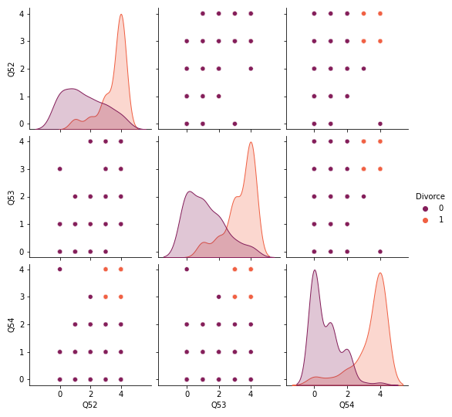
Pair Plots Using Python Q42-Q51 & Q52-Q54

Slide 22
Evaluation and Interpretation for Research Question 1
Which factors could lead to a divorce?
First criteria, if the questions that can clearly separate the divorce group and no divorce group.
Second criteria, if the 5th frequency bar is high and the orange curve is higher than the purple curve, that concludes those factors or questions mostly leading towards divorce.
The main questions that had factors highly correlating to a divorce are
Q3 = When we need it (argue)
Q31 = I feel aggressive when I argue with my spouse
Q32 = When discussing with my spouse
Q37 = My discussion with my spouse is not calm
Q39 = Our discussion often occur suddenly
Q42 = When I argue with my spouse - I only go out and I don’t say a word
Q43 = I mostly stay silent to calm the environment a little bit
Q45 = i’d rather stay silent than discuss with my spouse
Q47 = Even of i’m right in the discussion - I stay silent to to hurt my spouse
Q48 = I feel right in our discussions
Q49 = I have nothing to do with what i’ve been accused of
Q50 = I’m not actually the one who’s guilty about what i’m accused of
Q51 = I'm not the one who's wrong about problems at home
Q52 = I wouldn't hesitate to tell my spouse about his/her inadequacy
Q53 = When I discuss - I remind my spouse of spouse of her/his inadequacy

Slide 23
Data Exploration - Second Dataset
We used the second dataset to answer our second research question.
To find out the current situation in US divorce, our group used the world divorce rate dataset to visualize how the divorce rate changed in the US in last few decades. Based on this, we also tried to predict the divorce trend in the future ten years. [We used R to extract the subdataset from the original dataset and conducted the prediction with Tableau]
To compare the divorce situation in US with other countries, we picked some representatives from the 167 countries and used R to generate several visualizations.

Slide 24
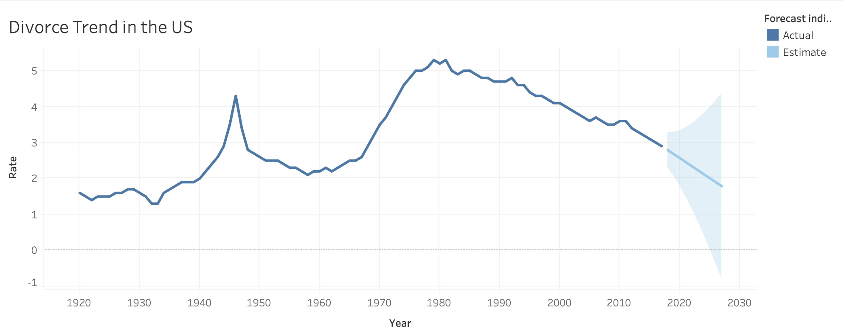
Research Question 2 - the current situation of divorce in the US using R and Tableau
Extract the subdataset divorce_usa from the original dataset in R
Load the subdataset into Tableau and conducted the prediction

Slide 25
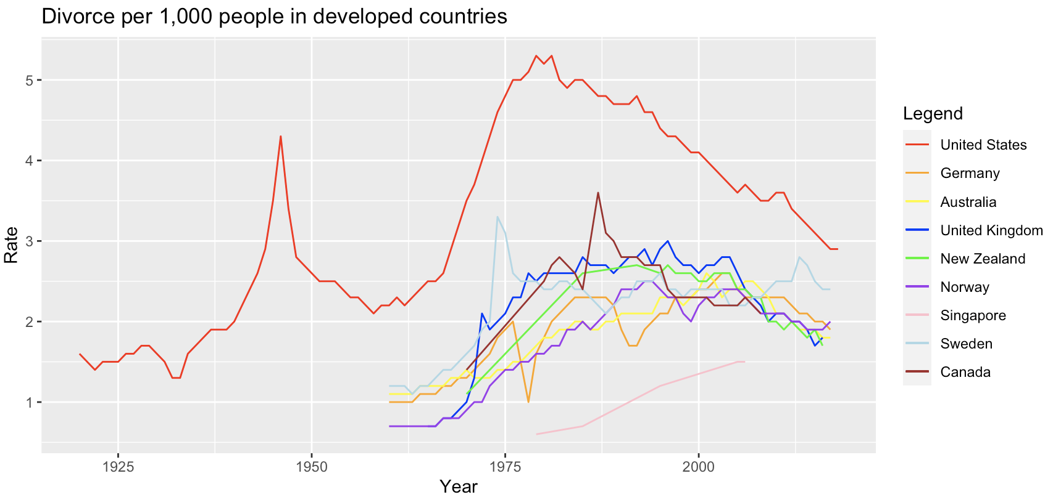
Research Question 2 - Comparisons with countries in divorce rate using R
Developed Countries

Slide 26
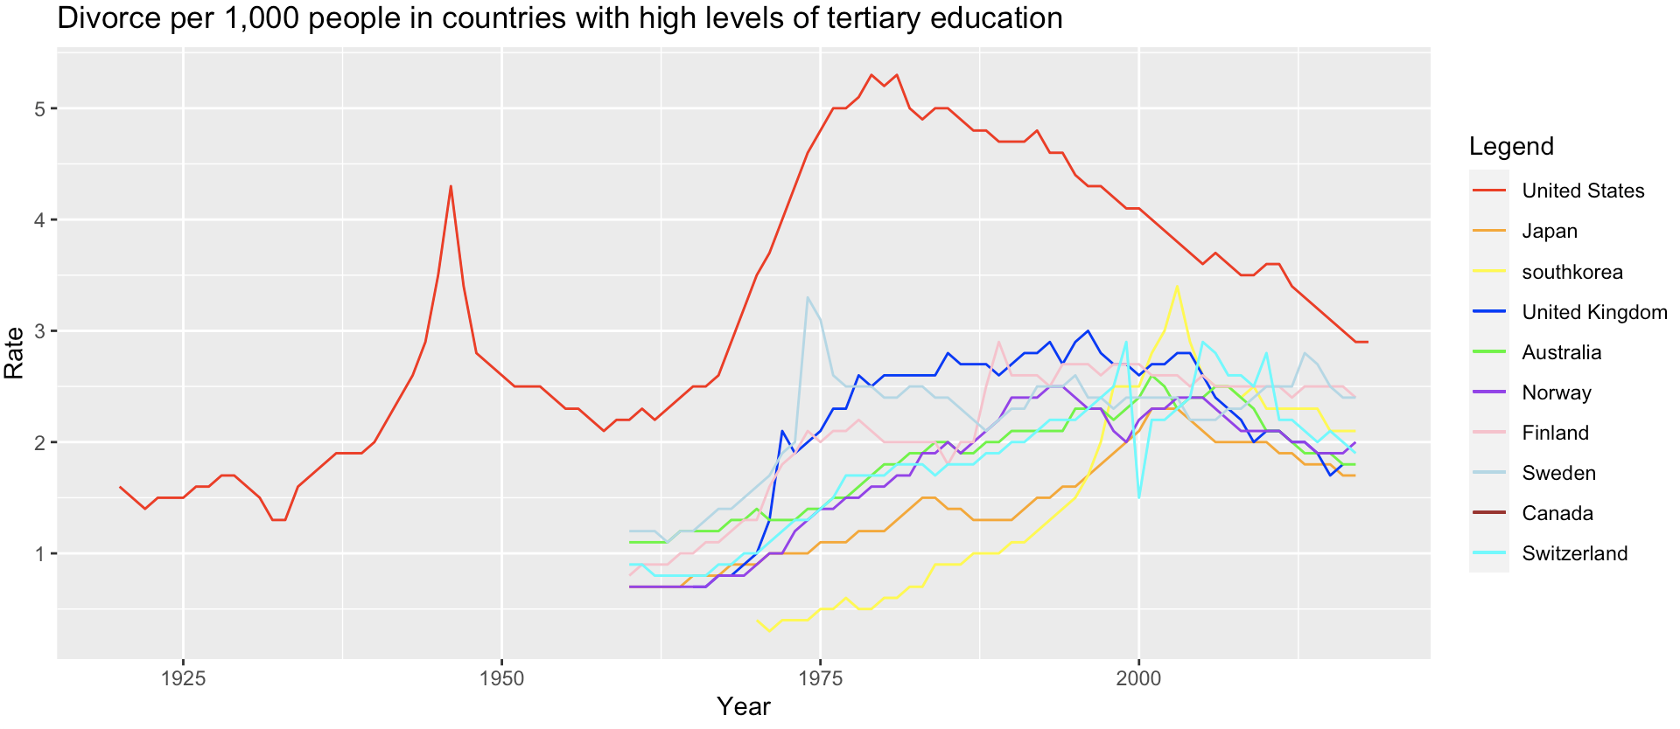
Research Question 2 - Comparisons with countries in divorce rate using R
Countries with high levels of tertiary education

Slide 27
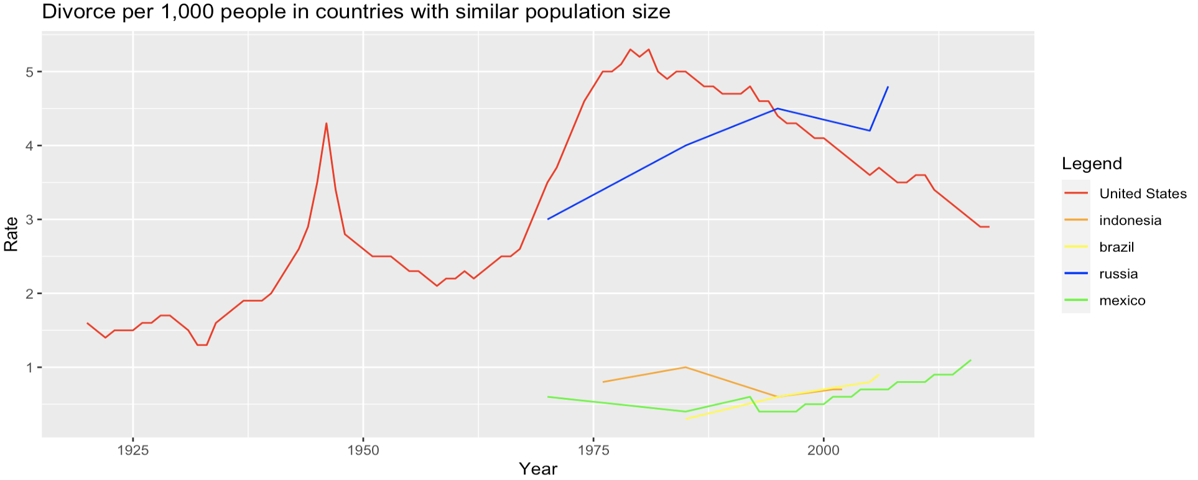
Research Question 2 - Comparisons with countries in divorce rate using R
Countries with similar population size

Slide 28
Evaluation and Interpretation for Research Question 2
What is the current situation of divorce in the US? Is it still a topic that need to be seriously considered compared to other countries?
The overall divorce rate in the US has been declining in recent years.
The divorce rate in the US dropped to 2.9 divorces per 1,000 population in 2018, which is the lowest rate recorded in over 50 years.
From the prediction, the divorce rate in the US would keep declining in the next ten years.
However, the divorce rate in the US is obviously higher than other countries sharing some similarities.
Therefore, divorce in the US is still a topic need to be seriously considered compared to other countries.

Slide 29
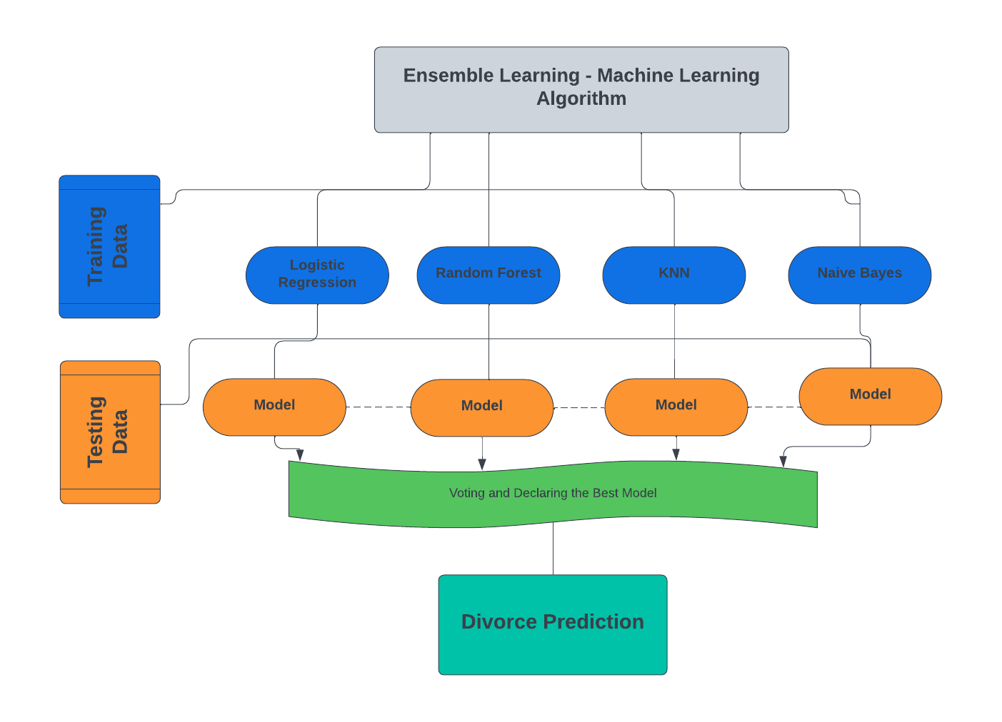
Approach

Slide 30
Model & Algorithm
Python:
Logistic Regression
Split the main dataset ->
from sklearn.model_selection import train_test_split
X_train,X_test,y_train, y_test=train_test_split(X,y,test_size=0.3,random_state=1)
Normalized the dataset by using the standardization method into the X training set and X testing set
Imported the LogisticRegression model from sklearn.linear_model module and set the random state to 100, and fit the X training set and y training set
Predicted the test results by using the X testing set
Created a confusion matrix and printed the accuracy to see how well the model worked

Slide 31
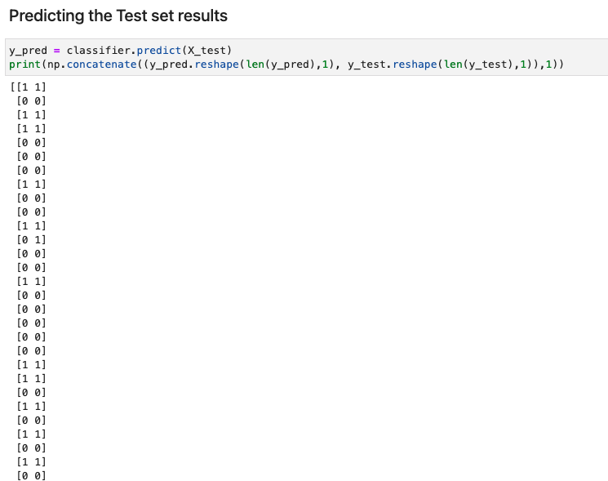
Test Set Results using the X Test set

Slide 32
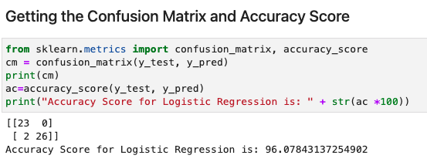
Evaluation & Interpretation
Using a Logistic regression model in python, we received a accuracy score of 96.08%
23 couples that are divorced are predicted correctly as divorced in the model as True Positive
26 couples that are not divorced are predicted correctly as not divorced in the model as True Negative
2 divorced couples are incorrectly predicted as not divorced by the model as False Negative
There are 0 false positives, 0 not divorced couples are predicted incorrectly in the model

Slide 33
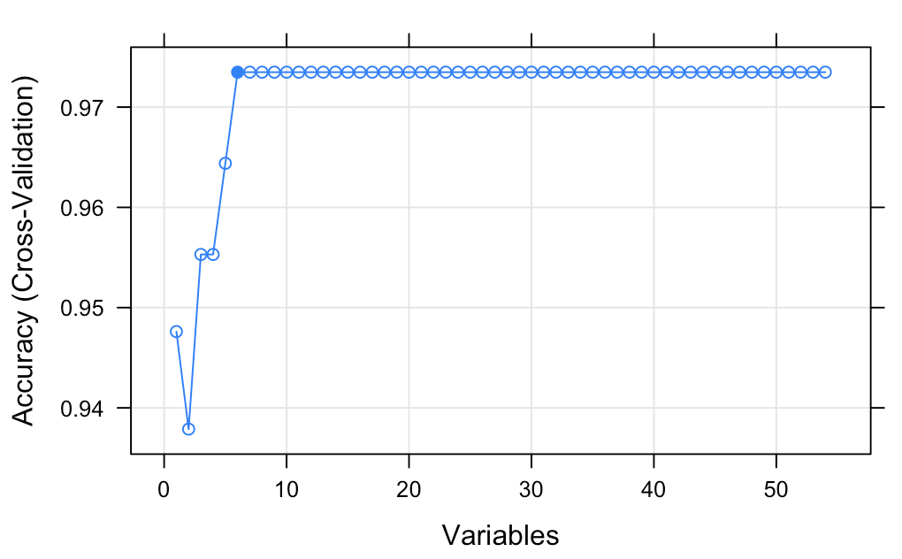
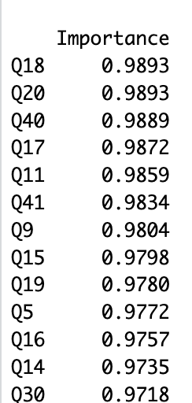
Model & Algorithm & Evaluation
R
Split the dataset into 70% training set and 30% testing set
Feature Selection
Recursive Feature Elimination
rfeControl(functions=rfFuncs, method = "cv", number = 10)
important features - "Q40" "Q18" "Q20" "Q11" "Q17" "Q9"
Backward Selection
backmodel <- step(all, direction = "backward")
important features - "Q40" "Q11" “Q6”
Learning Vector Quantization
importance_results <- train(Divorce~., data=divorce_df, method="lvq", preProcess="scale", trControl=ctrl2)
important features (>0.98) - "Q18" "Q20" "Q40" "Q17" "Q11" "Q41" "Q9"
Our Selection: "Q18" "Q40" "Q11" "Q6" "Q20" "Q17" "Q41" "Q9"
rfe_results
Variable importance

Slide 34
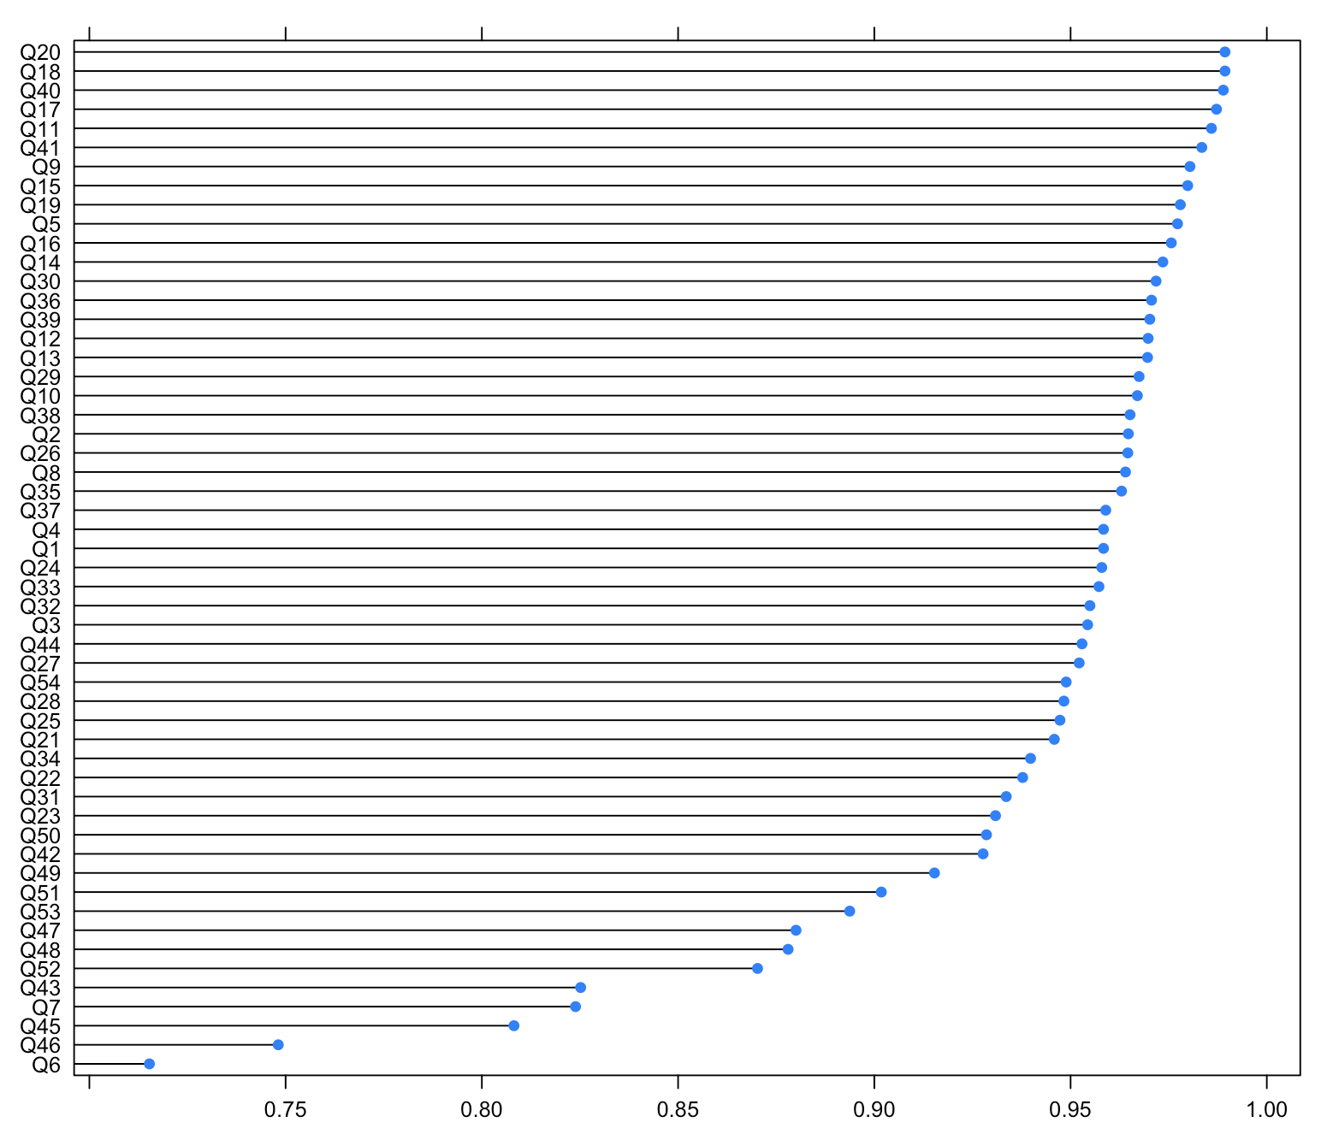
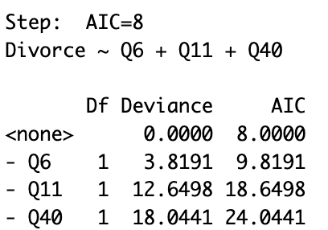
Model & Algorithm & Evaluation
R
Feature Selection
Feature importance by Learning Vector Quantization
Results of Backward Selection

Slide 35
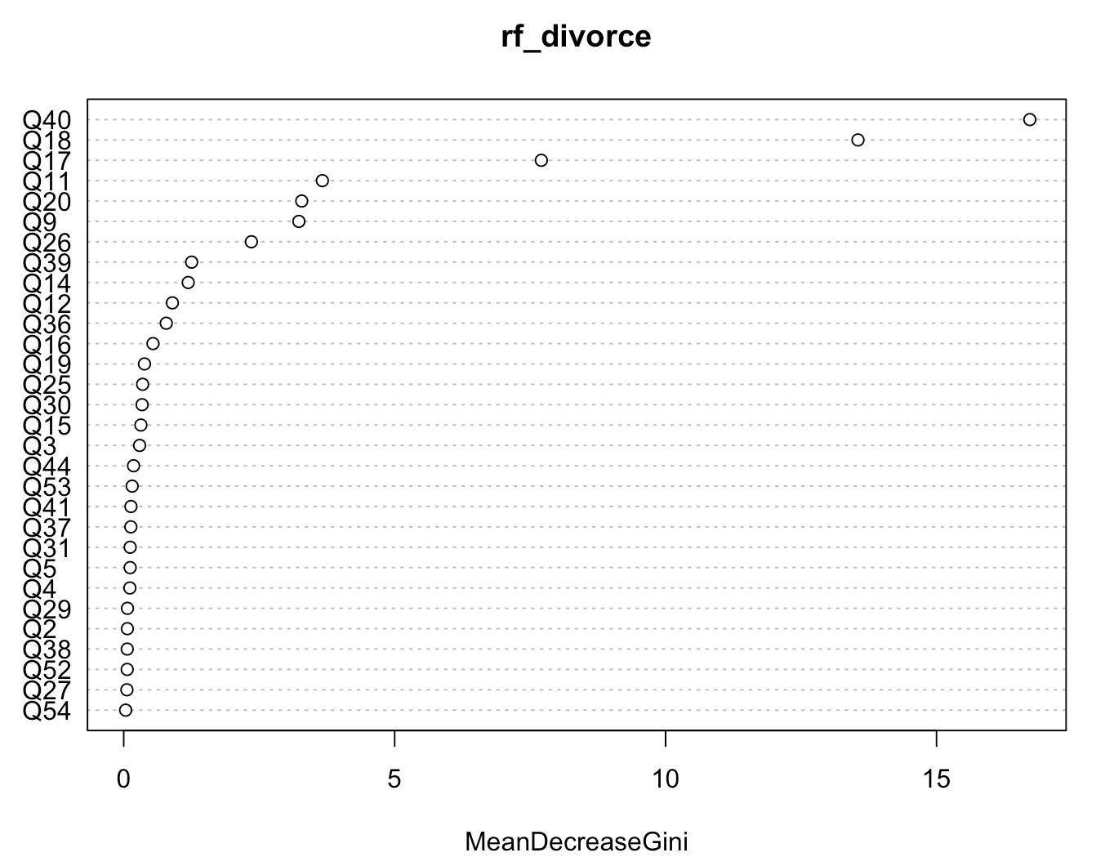
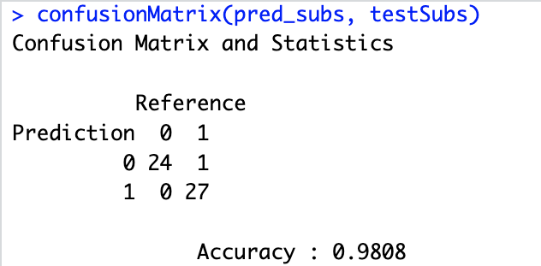
Model & Algorithm & Evaluation
R
Random Forest Algorithm
Modeling with all 54 features (mtry=50, ntree=512)
From the ‘importance’ plot, Q40, Q18, Q17, Q11, Q20, Q9 are the most important features for predicting.
Modeling with the selected features "Q18" "Q40" "Q11" "Q6" "Q20" "Q17" "Q41" "Q9" .
Predicted the test results with testing set.
Created a confusion matrix and printed the accuracy to see how well the model worked.
Testing Accuracy: 98%

Slide 36
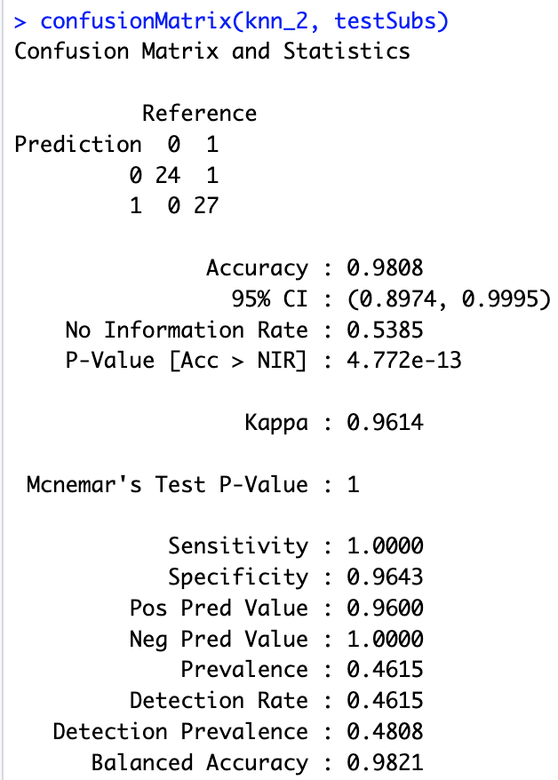
Model & Algorithm & Evaluation
R
K-Nearest Neighbors Algorithm （KNN）
Import the package “class”
Modeling with the selected features "Q18" "Q40" "Q11" "Q6" "Q20" "Q17" "Q41" "Q9"
knn_2 <- knn(train1Dat[, -1], test1Dat[, -1], cl=train1Dat[, 1], k = 3)
Created a confusion matrix and printed the accuracy to see how well the model worked.
Testing Accuracy: 98%

Slide 37
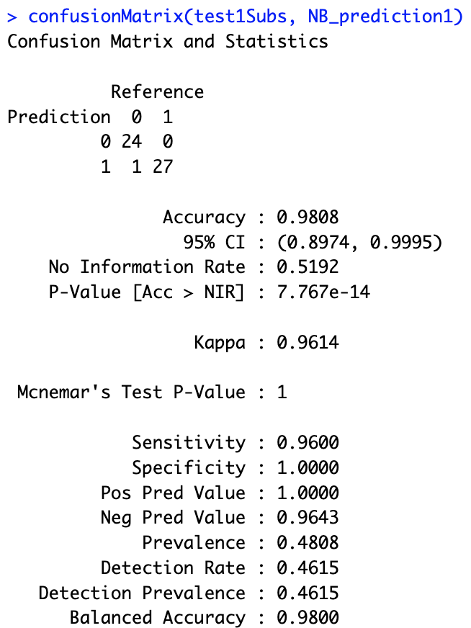
Model & Algorithm & Evaluation
R
Naive Bayes Algorithm
Import the package “naivebayes”
Modeling with the selected features "Q18" "Q40" "Q11" "Q6" "Q20" "Q17" "Q41" "Q9"
NB_model1 <- naive_bayes(Divorce ~ ., data = train1Dat, usekernel = T)
Predicted the test results with testing set.
NB_prediction1 <- predict(NB_model1, test1Dat[, -1])
Created a confusion matrix and printed the accuracy to see how well the model worked.
Testing Accuracy: 98%

Slide 38
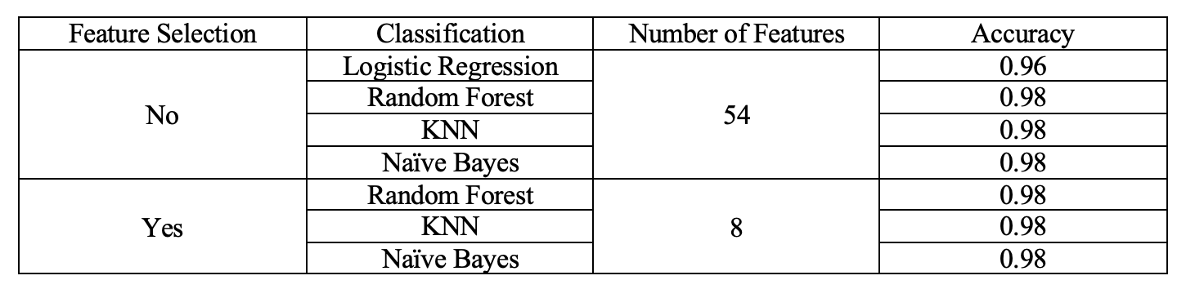
Result for Research Question 3
How accurately can the models predict how many couples are heading towards a divorce?
High accuracy can be achieved with all the prediction models based on all the 54 features.
After selecting the most important 8 features, the high accuracy can still be obtained.

Slide 39
Limitations
There weren’t much attributes to work with to get a full understanding of the first dataset
If there are more attributes, we could’ve gotten a better and deeper insight of which couples would lead into a divorce such as:
Income
Number of family members for the couples
Race
State
Country
Time
This dataset is just a overall survey that doesn’t have much information, so we had to add another dataset to get more insight of what is happening in the world with divorces.

Slide 40
Conclusion
Several factors, communication issues and aggression during arguments, can significantly increase the likelihood of a divorce.
Despite recent declines, the US divorce rate is still higher than other countries with comparable demographics.
The predictive models that were tested demonstrated different levels of success in predicting divorce, with all of the model algorithms exhibiting the highest level of accuracy.
In order to decrease the risk of divorce, further research is needed to increase the precision of forecasting marital outcomes and to emphasize the significance of improving communication and conflict resolution skills to minimize the likelihood of divorce.
xxxxxcccxx

Slide 41
References
https://archive.ics.uci.edu/ml/datasets/Divorce+Predictors+data+set# [1]
https://www.analyticsvidhya.com/blog/2015/11/beginners-guide-on-logistic-regression-in-r/#:~:text=log(p%2F1%2Dp,association%20in%20a%20linear%20way.&text=This%20is%20the%20equation%20used%20in%20Logistic%20Regression.
https://www.kaggle.com/datasets/andrewmvd/divorce-prediction
https://en.wikipedia.org/wiki/Logistic_regression
https://ourworldindata.org/marriages-and-divorces
Google Images for Background, DIKW Model, and Thank You picture

Slide 42


